Slide 1
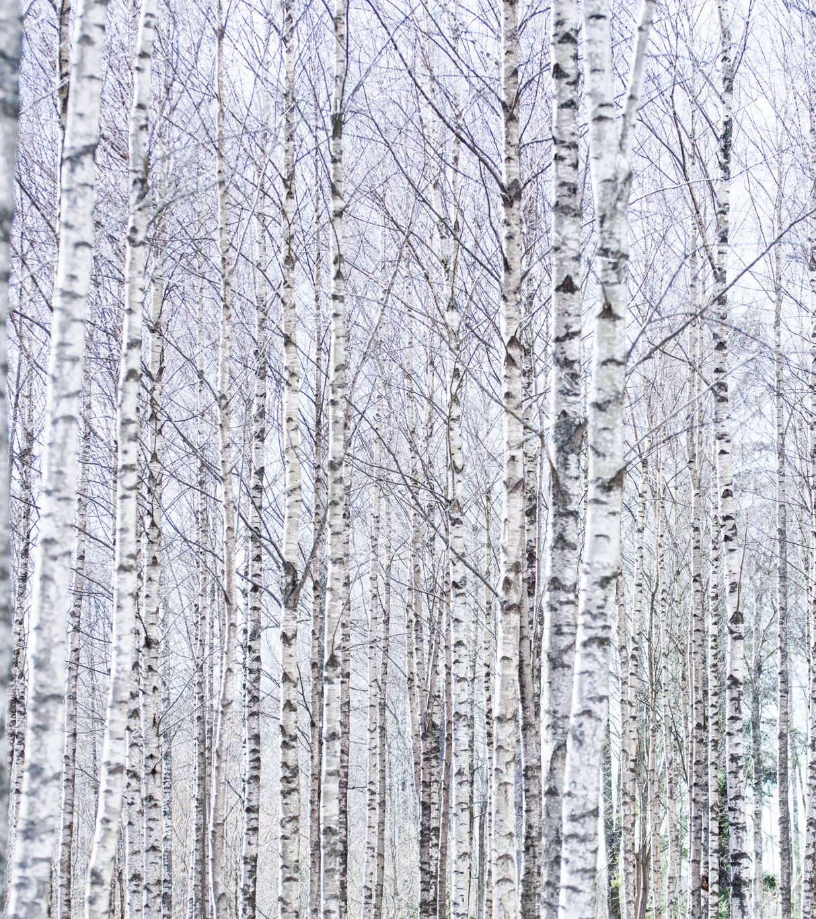
Tree plantation
ViSit the local sachivalayam and take the permissions from MRO and president of our village about the community service project. 2.Start the tree plantation in our local area and make people aware about the trees. 3.Conduct survey on our area and make a decision to plant trees. 4.On that time some people are inspired and they also make tree plantations. 5.They can also make other people aware about how trees are useful and how tree are important to us.

Slide 2
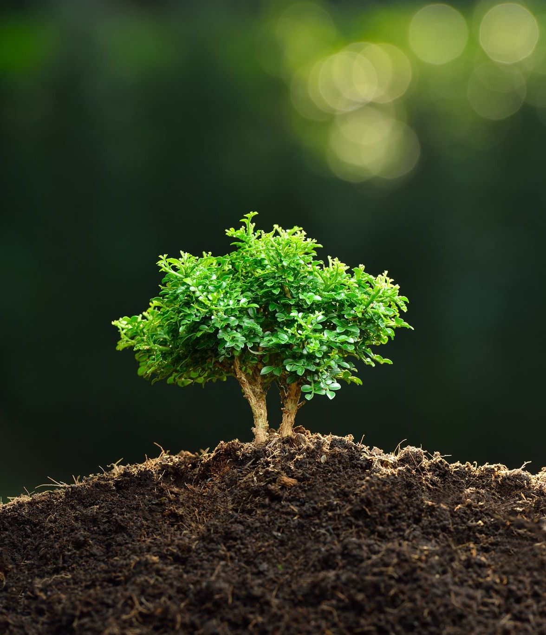
Abstract
Tree-planting is the process of transplanting tree seedlings, generally for forestry, land reclamation, or landscaping purposes. It differs from the transplantation of larger trees in arboriculture and from the lower-cost but slower and less reliable distribution of tree seeds.
Plantation forestry can produce a high volume of wood in a short period of time. Plantations are grown by state forestry authorities (for example, the Forestry Commission in Britain) and/or the paper and wood industries and other private landowners (such as Weyerhaeuser, Rayonier and Sierra Pacific Industries in the United States or Asia Pulp & Paper in Indonesia). Christmas trees are often grown on plantations, and in southern and southeastern Asia, teak plantations have recently replaced the natural forest.

Slide 3

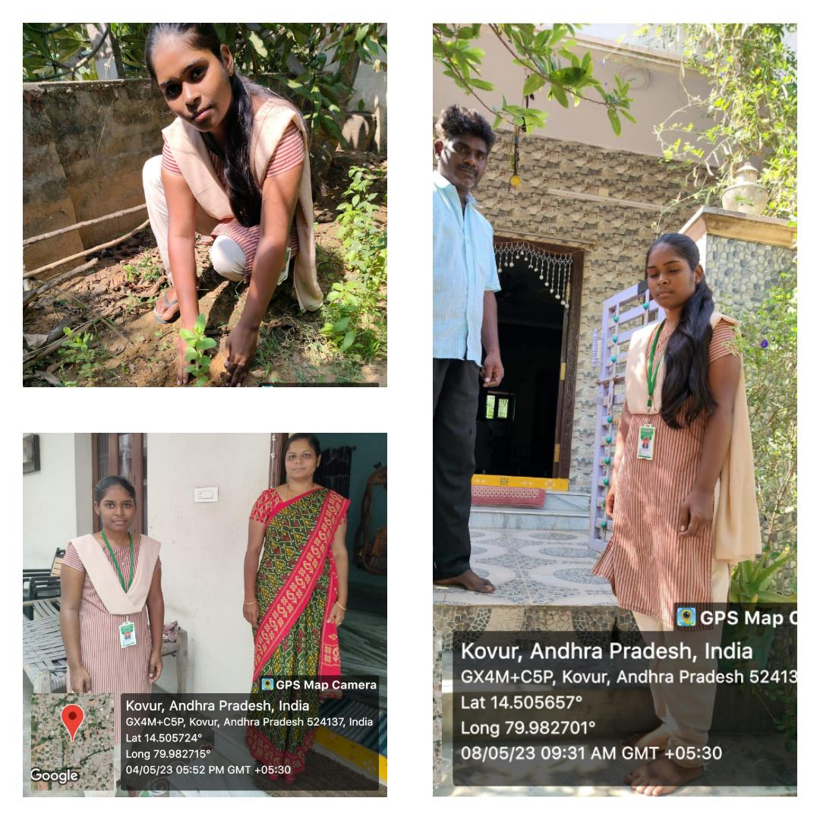
Project Activity

